Slide 1
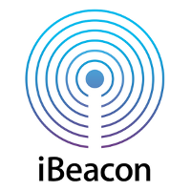
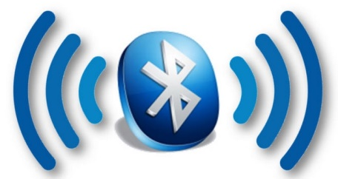
Bluetooth and iBeacon
YD

Slide 2
Introduction
Bluetooth is a wireless technology standard for exchanging data over short distances (using short-wavelength UHF radio waves in the ISM band from 2.4 to 2.485 GHz) from fixed and mobile devices, and building personal area networks (PANs).

Slide 3
Introduction
Bluetooth is managed by the Bluetooth Special Interest Group (SIG), which has more than 25,000 member companies in the areas of telecommunication, computing, networking, and consumer electronics.
The IEEE standardized Bluetooth as IEEE 802.15.1, but no longer maintains the standard.

Slide 4
Introduction
A manufacturer must make a device meet Bluetooth SIG standards to market it as a Bluetooth device.

Slide 5
Introduction
A master Bluetooth device can communicate with a maximum of seven devices in a piconet (an ad-hoc computer network using Bluetooth technology), though not all devices reach this maximum.
The devices can switch roles, by agreement, and the slave can become the master (for example, a headset initiating a connection to a phone necessarily begins as master—as initiator of the connection—but may subsequently operate as slave).

Slide 6
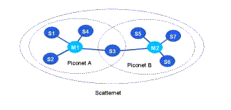
Introduction
The Bluetooth Core Specification provides for the connection of two or more piconets to form a scatternet, in which certain devices simultaneously play the master role in one piconet and the slave role in another.

Slide 7
Introduction
At any given time, data can be transferred between the master and one other device.
The master chooses which slave device to address; typically, it switches rapidly from one device to another in a round-robin fashion.

Slide 8
Introduction
Bluetooth is a standard wire-replacement communications protocol primarily designed for low-power consumption, with a short range based on low-cost transceiver microchips in each device.

Slide 9
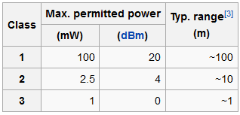
Introduction
Range is power-class-dependent, but effective ranges vary in practice; see the table on the right.

Slide 10
How much energy does traditional Bluetooth use?
Traditional Bluetooth is connection oriented. When a device is connected, a link is maintained, even if there is no data flowing.
Sniff modes allow devices to sleep, reducing power consumption to give months of battery life.
Peak transmit current is typically around 25mA
Even though it has been independently shown to be lower power than other radio standards, it is still not low enough power for coin cells.

Slide 11
ZigBee and Bluetooth Low Energy
Business comparison:
ZigBee is not in PCs or mobile phones yet.
Technical comparison:
Zigbee is low power; Bluetooth LE is even lower.
ZigBee stack is light; the Bluetooth stack is even simpler

Slide 12
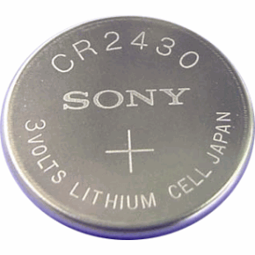
What is Bluetooth Low Energy?
Bluetooth low energy is a NEW, open, short range radio technology
Different to Bluetooth classic
Optimized for ultra low power
Enable coin cell battery use cases
< 20mA peak current
< 5 uA average current

Slide 13
Bluetooth low energy (Bluetooth 4.0) factsheet
Range: | ~ 150 meters open field
Output Power: | ~ 10 mW (10dBm)
Max Current: | ~ 15 mA
Latency: | 3 ms
Topology: | Star
Modulation: | GFSK @ 2.4 GHz
Security: | 128bit AES CCM
Sleep current: | ~ 1μA
Modes: | Broadcast, Connection, Event Data Models, Reads, Writes

Slide 14
Bluetooth low energy factsheet
Data Throughput
It has a data rate of 1Mbps, but is not optimized for file transfer.
It is designed for sending small chunks of data.

Slide 15
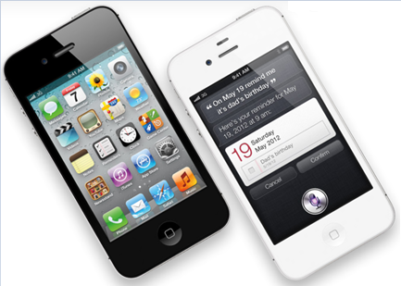
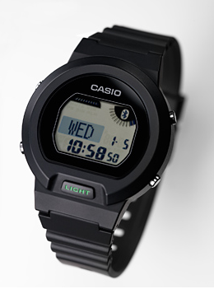
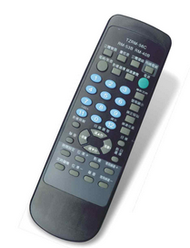
Device Modes
Dual Mode
Bluetooth BR/EDR and LE
Basic Rate/Enhanced Data Rate (BR/EDR)
Used anywhere that BR/EDR is used today
Single Mode
Implements only Bluetooth low energy
Will be used in new devices/applications

Slide 16
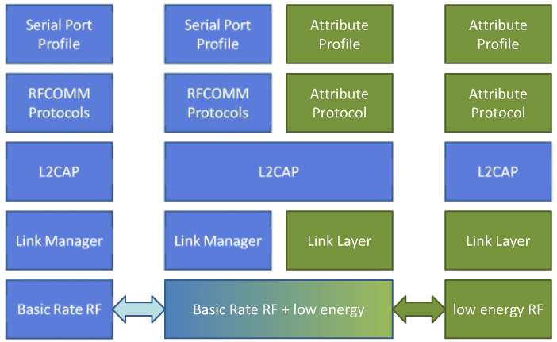
Device Modes
BR/EDR stack
Dual-mode stack
Single-mode stack

Slide 17
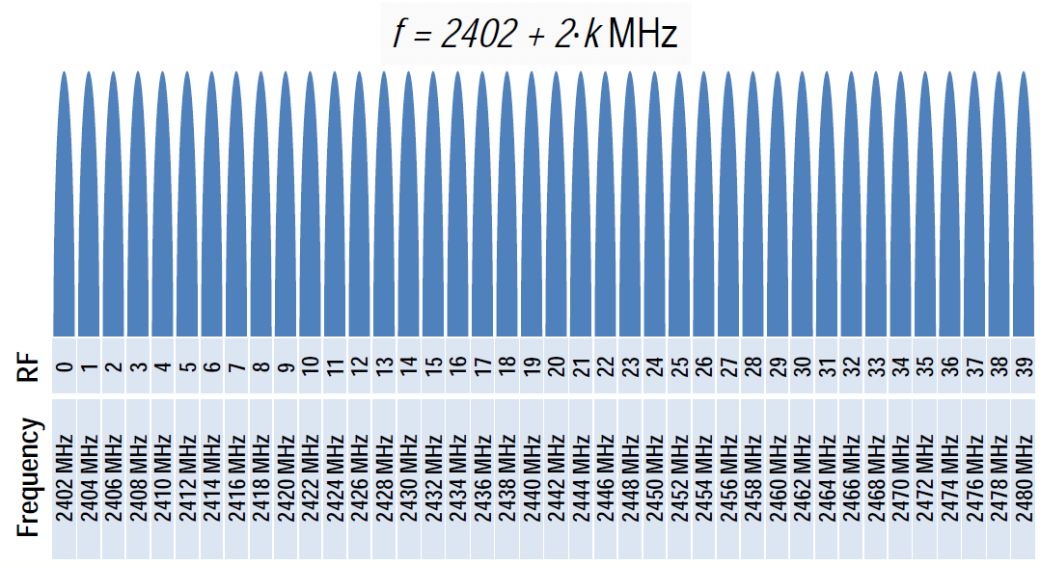
Physical Layer
2.4 GHz ISM band
1Mbps
40 Channels

Slide 18
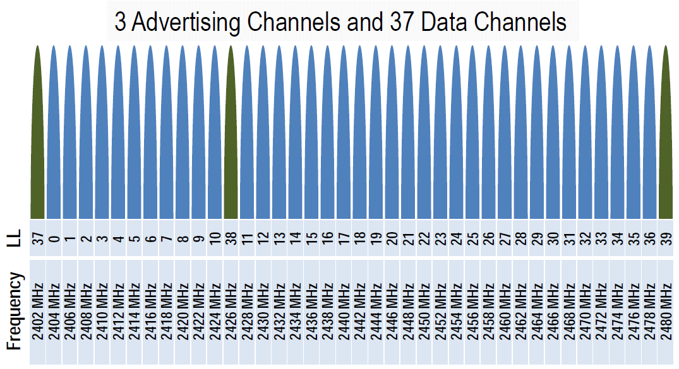
Physical Channels
Two types of channels
LL: Link Layer

Slide 19
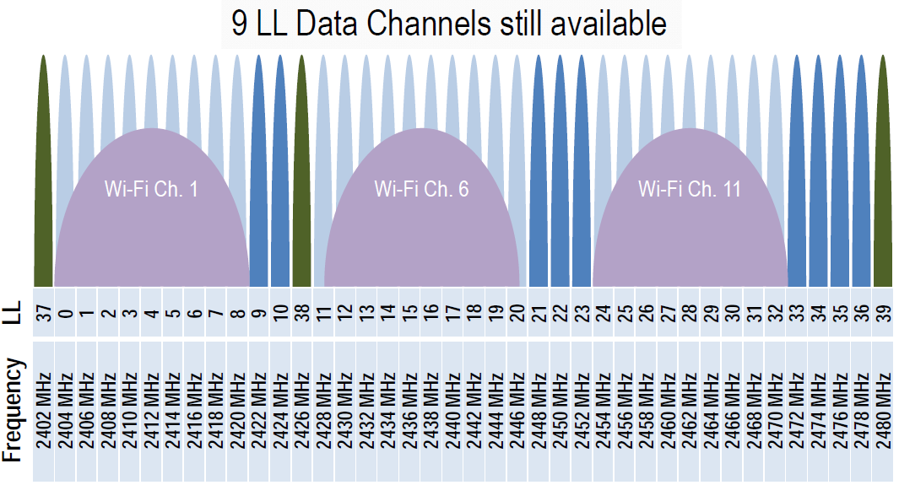
Physical Channels
Advertising channels avoid 802.11

Slide 20
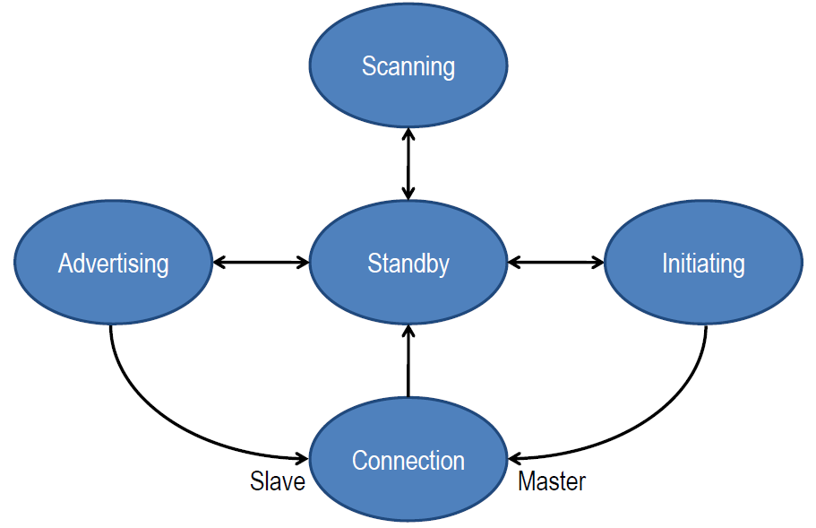
Link Layer
Link Layer state machine

Slide 21
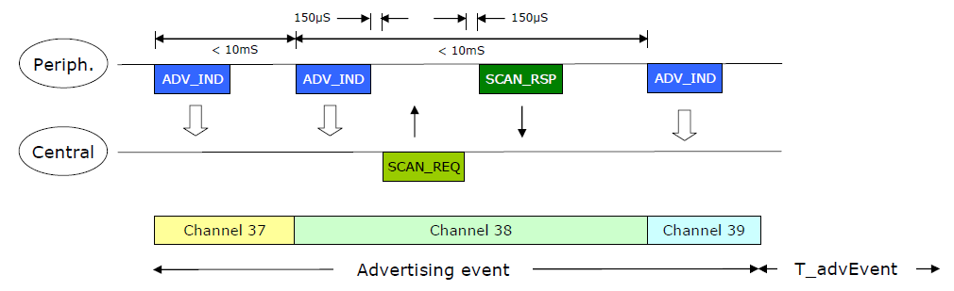
Advertising
Devices can advertise for a variety of reasons:
To broadcast promiscuously
To advertise their presence to a device wanting to connect
To reconnect asynchronously
Notes:
peripheral device

Slide 22
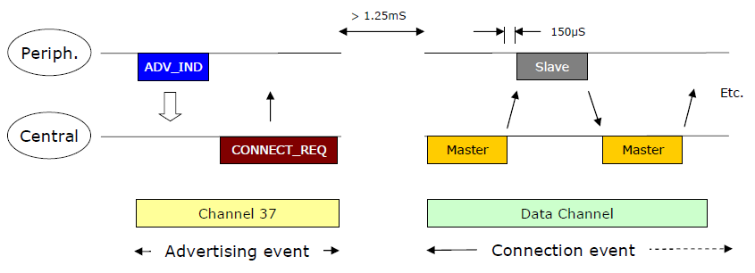
Data transactions
Once a connection is made:
Master informs slave of hopping sequence and when to wake
All subsequent transactions are performed in the 37 data channels
Transactions can be encrypted

Slide 23
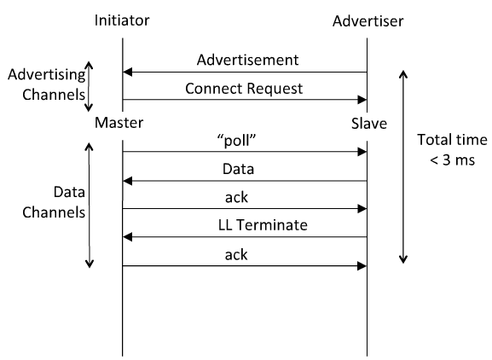
Link Layer Connection
Very low latency connection

Slide 24
Application of BLE:
iBeacon

Slide 25
What is iBeacon?
The term iBeacon and Beacon are often used interchangeably.
iBeacon is the name for Apple’s technology standard, which allows Mobile Apps (running on both iOS and Android devices) to listen for signals from beacons in the physical world and react accordingly.
iBeacon technology allows Mobile Apps to understand their position on a micro-local scale, and deliver hyper-contextual content to users based on location.
The underlying communication technology is Bluetooth Low Energy.

Slide 26
How does BLE communication work?
BLE communication consists primarily of “Advertisements”, or small packets of data, broadcast at a regular interval by Beacons or other BLE enabled devices via radio waves.

Slide 27
How does BLE communication work?
BLE Advertising is a one-way communication method. Beacons that want to be “discovered” can broadcast, or “Advertise” self-contained packets of data in set intervals.
These packets are meant to be collected by devices like smartphones, where they can be used for a variety of smartphone applications to trigger things like push messages, app actions, and prompts.

Slide 28
How does BLE communication work?
Apple’s iBeacon standard calls for an optimal broadcast interval of 100 ms. Broadcasting more frequently uses more battery life but allows for quicker discovery by smartphones and other listening devices.

Slide 29
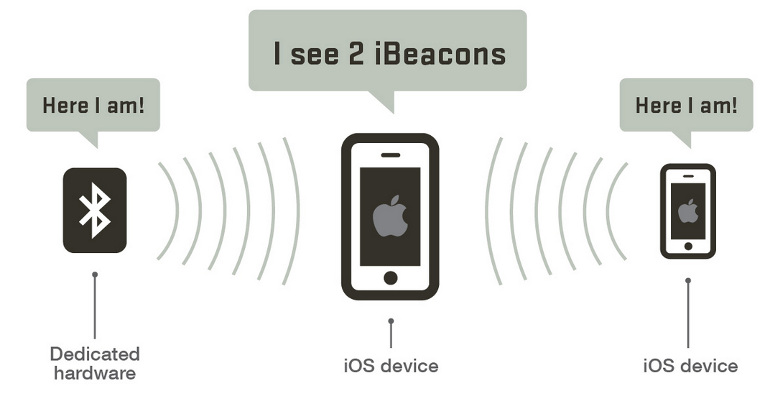
How does BLE communication work?
Standard BLE has a broadcast range of up to 100 meters, which make Beacons ideal for indoor location tracking and awareness.

Slide 30
How does iBeacon use BLE communication?
With iBeacon, Apple has standardized the format for BLE Advertising.
Under this format, an advertising packet consists of four main pieces of information.

Slide 31
How does iBeacon use BLE communication?
UUID: This is a 16 byte string used to differentiate a large group of related beacons.
For example, if Coca-Cola maintained a network of beacons in a chain of grocery stores, all Coca-Cola beacons would share the same UUID. This allows Coca-Cola’s dedicated smartphone app to know which beacon advertisements come from Coca-Cola-owned beacons.

Slide 32
How does iBeacon use BLE communication?
Major: This is a 2 byte string used to distinguish a smaller subset of beacons within the larger group.
For example, if Coca-Cola had four beacons in a particular grocery store, all four would have the same Major. This allows Coca-Cola to know exactly which store its customer is in.

Slide 33
How does iBeacon use BLE communication?
Minor: This is a 2 byte string meant to identify individual beacons.
For the Coca-Cola example, a beacon at the front of the store would have its own unique Minor. This allows Coca-Cola’s dedicated app to know exactly where the customer is in the store.

Slide 34
How does iBeacon use BLE communication?
Tx Power: This is used to determine proximity (distance) from the beacon.
How does this work?
TX power is defined as the strength of the signal exactly 1 meter from the device. This has to be calibrated and hardcoded in advance.
Devices can then use this as a baseline to give a rough distance estimate.

Slide 35
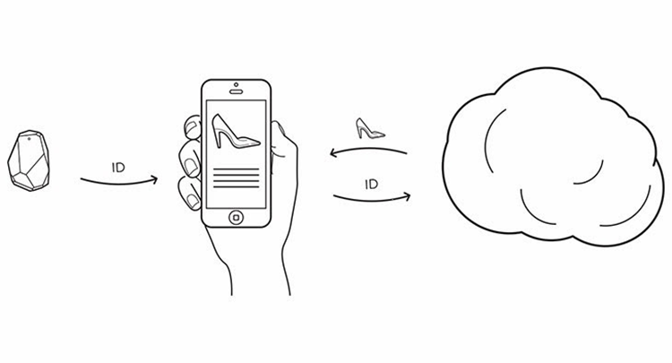
How does iBeacon use BLE communication?
Example: (A beacon broadcasts the following packet)
UUID: 12345678910245
Major: 22
Minor: 2
Power: 200
A device receiving this packet would understand it’s from the Coca-Cola Beacon (UUID) in the Target on 1st Street (Major) at the front of the store (Minor).

Slide 36

How does iBeacon use BLE communication?
https://www.youtube.com/watch?v=sUIqfjpInxY

Slide 37
Trigger iBeacon
Step 1: (install development lib)
$sudo apt-get -y install libglib2.0-dev libudev-dev libical-dev libreadline-dev libdbus-1-dev
Step 2: (intall Bluetooth tool package: BlueZ)
$wget http://www.kernel.org/pub/linux/bluetooth/bluez-5.28.tar.xz
Step 3: (de-compress file)
$unxz bluez-5.28.tar.xz && tar xvf bluez-5.28.tar
Step 4: (compile and install)
$cd bluez-5.28 $LDFLAGS=-lrt ./configure --disable-systemd $make -j4 $sudo make install

Slide 38
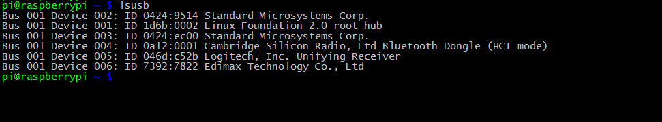
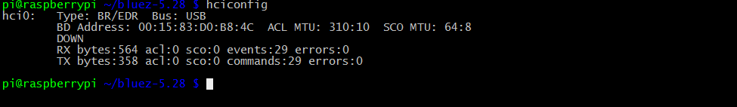
Trigger iBeacon
Step 6: (list usb)
$lsusb
Step 7: (check Bluetooth device)
$hciconfig

Slide 39
Trigger iBeacon
Step 8: close the capability of scanning and only reserve beacon
$sudo hciconfig hci0 up $sudo hciconfig hci0 noscan
Step 9: launch broadcasting of BLE
$sudo hciconfig hci0 leadv

Slide 40
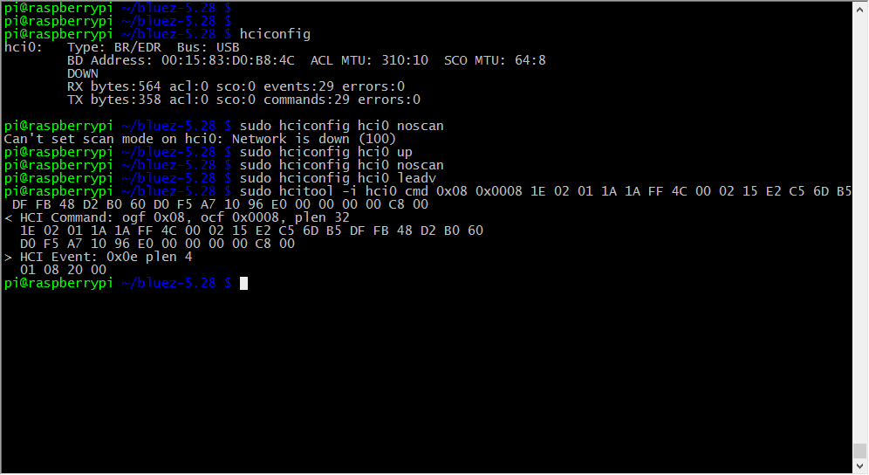
Trigger iBeacon
Step 10: test iBeacon packet
$sudo hcitool -i hci0 cmd 0x08 0x0008 1E 02 01 1A 1A FF 4C 00 02 15 E2 C5 6D B5 DF FB 48 D2 B0 60 D0 F5 A7 10 96 E0 00 00 00 00 C8 00

Slide 41
Data formats
0x08 0x0008 1E 02 01 1A 1A FF 4C 00 02 15 <UUID> <MAJOR> <MINOR> <POWER> 00
0x08 0x0008 is to set the LE advertising data (Operation Group Field (OGF) = Bluetooth Command Group = 0x08) (Operation Command Field (OCF)= HCI_LE_Set_Advertising_Data = 0x0008)
1E is number of significant data octets
iBeacon Prefix (Always Fixed) = 02 01 1A 1A FF 4C 00 02 15

Slide 42
Data formats
02 is number of bytes that follow in first AD (advertising data) structure
01 is flags AD type
1A is flags value 0x1A = 000011010
bit 0 (OFF) LE Limited Discoverable Mode
bit 1 (ON) LE General Discoverable Mode
bit 2 (OFF) BR/EDR Not Supported
bit 3 (ON) Simultaneous LE and BR/EDR to Same Device Capable (controller)
bit 4 (ON) Simultaneous LE and BR/EDR to Same Device Capable (Host)
1A is number of bytes that follow in second (and last) AD structure
0xFF marks the beginning of the manufacturing specific data bloc
0x4C 0x00 is Apple manufacturer code
0x02 is the data type
0x15 is the length of the remaining data

Slide 43
Now, taking your smart phone

Slide 44
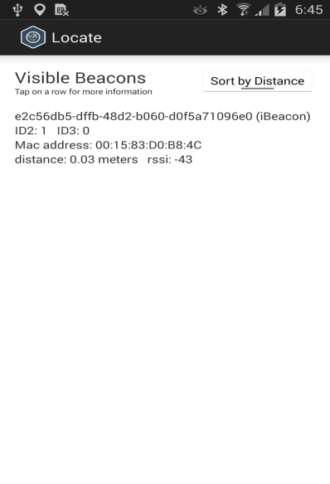
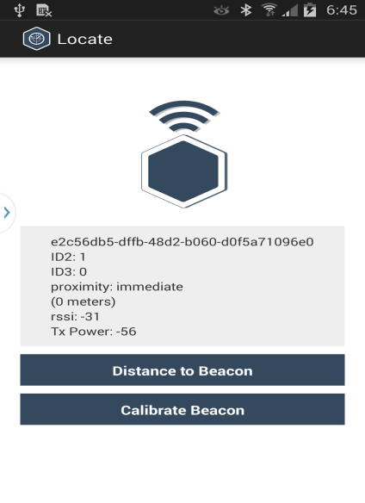
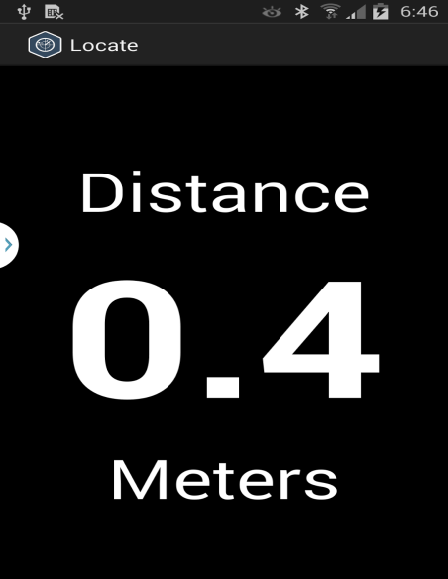
Install APP and Locate
iPhone/iPad/Android
Install “Locate Beacon” APP

Slide 45
Ibeacon scanner
YD

Slide 46
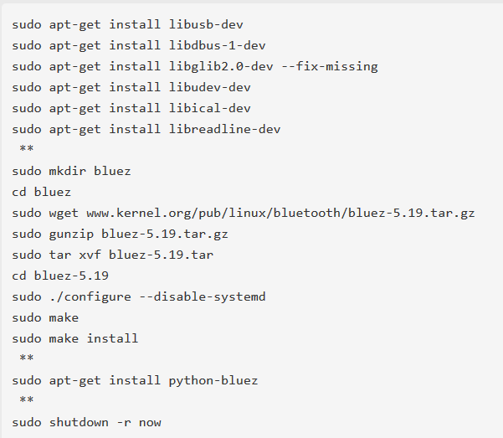
Installing BlueZ
To install a new version of BlueZ on the Pi, do the following:

Slide 47
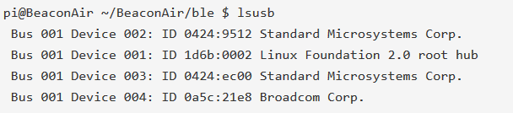

Installing BlueZ
Now you have BlueZ installed and running on your Raspberry Pi. Next, install your USB Bluetooth 4.0 Dongle and test it:
Note that your USB Bluetooth dongle should show similar information, depending on what you have plugged into your USB bus. You can see a lot more information about the USB device by typing:

Slide 48
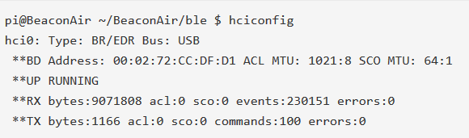
Installing BlueZ
Now you can look for the Bluetooth device using hciconfig:
Finally, turn on the device

Slide 49
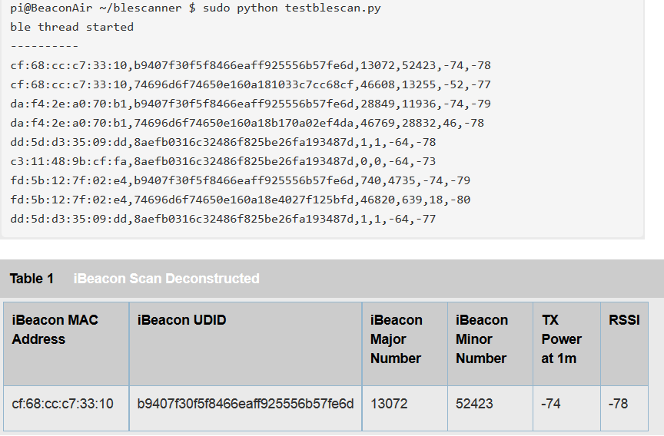
Test it
Run the blescanner command to see what iBeacons might be around you. If you don't have an iBeacon, you can simulate one with either your iPhone or Android phone running any of a number of apps in the app stores.

Slide 50
Sample code
https://drive.google.com/open?id=0B5oIgJE84UwCdnUxVGE2NTJIems

Slide 51
Lab 6: Locate where you are
Using ibeacon signal strength to compute the distance and locate where you are at indoor

Slide 52
End

